Slide 1
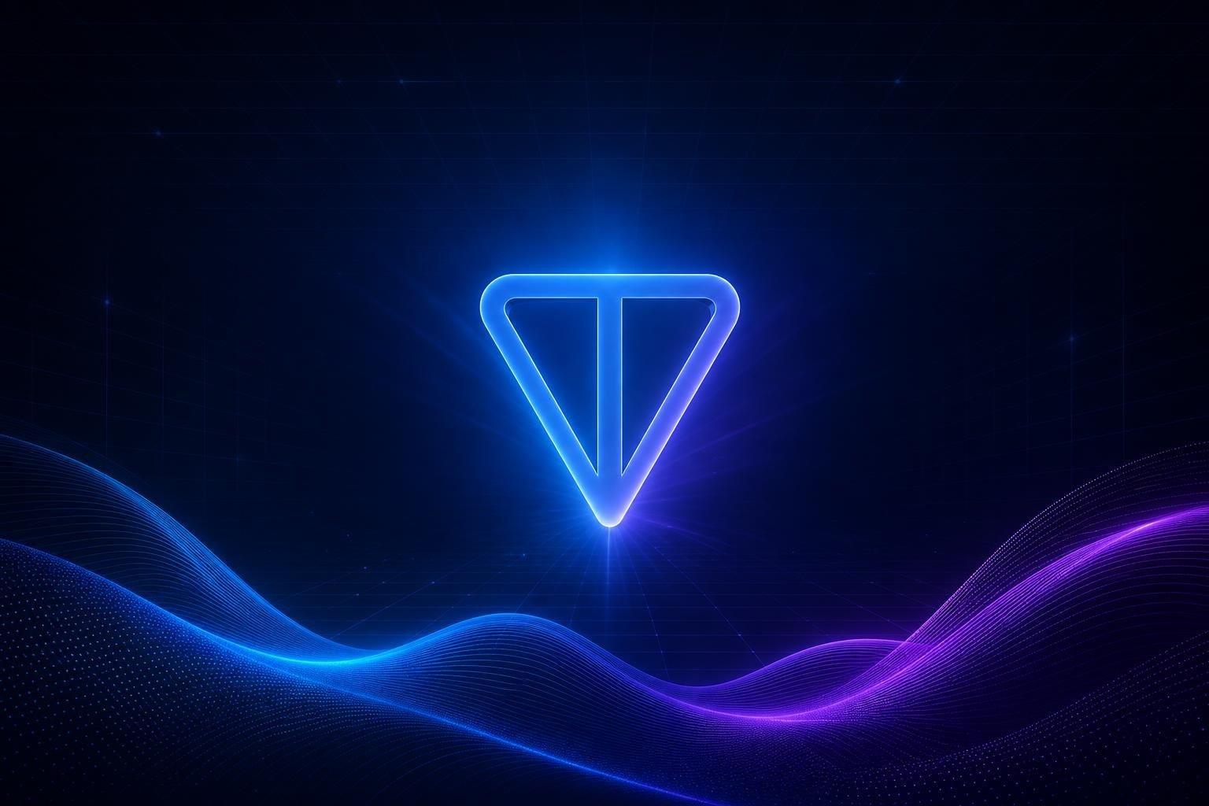
ArrayWallets — Smart Wallet Analytics & Cross-Chain Swaps on TON
Built for STON.fi Vibe Coding Hackathon Wave 2 —
STON.fi Track + Mira Track

Slide 2
The Problem
TON blockchain has 54M+ active wallets, but no unified analytics dashboard
Users can't track portfolio PnL, swap performance, or jetton price changes in one place
Cross-chain swaps require navigating multiple DEXs and bridges — fragmented UX
Wallet data is scattered across TonAPI endpoints with no aggregated view

Slide 3

Our Solution
ArrayWallets — all-in-one platform
1. Wallet Explorer — browse, search, and analyze any TON wallet
2. Jetton Portfolio & PnL — real-time price tracking assets onchain
3. Swap Analytics — inferred swap detection, PnL per jetton
4. Cross-Chain Swaps — Omnistone integration for seamless multi-chain swaps
5. AI-Powered Insights — Mira AI agent for media content and documentations

Slide 4
Tech Stack
Layer | Technology
Framework | Next.js 16 (App Router)
Database | PostgreSQL + Prisma 7
Auth | Auth.js v5 + TON Connect
Blockchain | @ton/core, TonAPI
Cross-chain | STON.fi Omniston SDK v1beta8
EVM Connect | Reown AppKit (WalletConnect)
UI | Radix UI, shadcn/ui, Tailwind CSS 4
Deployment | Docker / Vercel
AI Agents | Mira (@mira), Cursor

Slide 5

Omniston Integration
Cross-chain swaps powered by STON.fi Omniston SDK
Omniston SDK — WebSocket-based routing for best-price cross-chain swaps
Reown AppKit — EVM wallet connection (MetaMask, WalletConnect, etc.)
Production endpoint — `wss://omni-ws.ston.fi` (no staging needed)
Swap flow: User selects tokens → Omniston routes → Best price execution → On-chain settlement
No bridges, no wrapped tokens — native cross-chain via aggregated liquidity

Slide 6
TonAPI Integration
TonAPI — the backbone of wallet data
Wallet Events — real-time transaction history with action classification
Jetton Prices — USD/TON prices with 24h, 7d, 30d percentage changes
Address Metadata — scam flags, verification status, action counts
Sync Engine — pulls TonAPI data into PostgreSQL for fast queries & historical analysis

Slide 7
Mira AI Integration
Mira AI agent — integrated into the development workflow
All project materials — README, presentation text, descriptions were created using @mira
Code assistance — Mira helped scaffold components, debug integrations, and generate documentation
Hackathon compliance — Mira is embedded in the development process AND the product presentation workflow

Slide 8
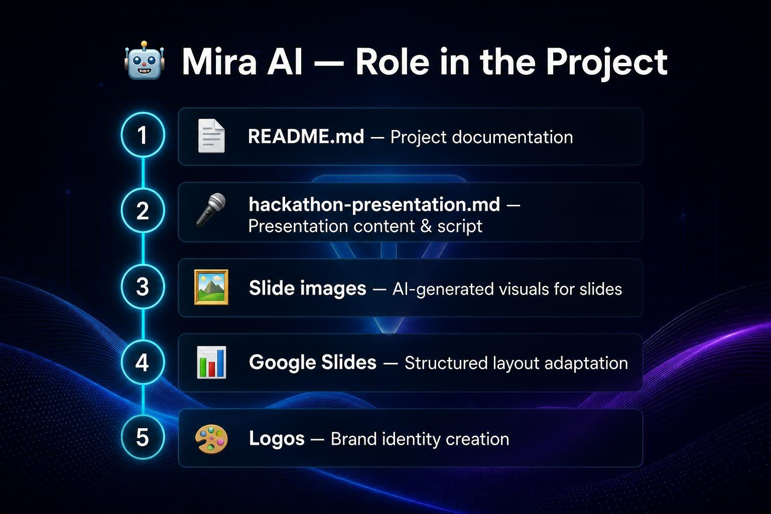

Slide 9
Wallet Explorer & PnL
Wallet Explorer — deep analytics for any TON wallet
Search any TON address → instant overview
Event history with pagination and filters
Jetton holdings with real-time price tracking
Portfolio PnL calculation per jetton
Swap detection: automatically infers swaps from transaction actions
Admin role system (wallet address)

Slide 10
Live Product Demo
https://wallets.arrayton.com
Wallet list with search and overview
Wallet detail: events, balances, PnL
Jetton portfolio with price changes
Omnistone cross-chain swap interface
Sign-in with TON Connect

Slide 11
What Makes Us Different
Why Wallets App stands out
All-in-one — Analytics + Swaps + AI in a single platform
Real PnL — Not just balances, but actual profit/loss tracking per jetton
Cross-chain native — Omnistone swaps without leaving the app
AI-assisted — Mira integration for development AND user-facing features
Production-ready — Docker, health checks, auth, deployed on Vercel
Open architecture — Modular codebase, easy to extend

Slide 12
Roadmap
What's next
Phase 2 — Multi-wallet portfolio aggregation
Phase 3 — Telegram Mini App for mobile-first experience
Phase 4 — DeFi yield tracking and staking analytics
Phase 5 — Statistic aggregation
Phase 6 — Integration in ArrayTon.com

Slide 13
Thank you!
🔗 Live app: https://wallets.arrayton.com
📂 GitHub: https://github.com/rAndom1zeeeR/ton-wallets
📂 Mira: https://wallets.arrayton.com/mira/export/messages.html
🤖 Built with Mira AI agent (@mira)
⚡ Powered by STON.fi Omniston SDK

